Slide 1

A discrete age-structured mathematical model for the application of measles vaccination strategies Ziyabukwa Mthi Supervisor: Dr L. Bolton Co-supervisor: Mr. J. Bingham Department of Mathematical Sciences Stellenbosch University South Africa 21 0ctober 2022

Slide 2
Introduction
Measles background
Measles is Vaccine Preventable Disease.
Measles transmission.
Incubation period.
Mortality cases.

Slide 3
Measles Vaccination
Measles vaccine
Public Health Intervention
Vaccine Schedule
Vaccination Awareness
MMR1 at 6 – 12 months
MMR 2 at 1 – 5 years

Slide 4
Discrete age structure
Age distribution
Non-uniformity in transmission rates
Application of measles vaccination strategies
Control of measles epidemics

Slide 5
Research question
How would different vaccination strategies influence the transmission of measles in population?
Research objectives
To explore transmission dynamics of measles in age-structured host population.
To study the vaccination strategies for measles with discrete age structure.
To evaluate the effectiveness of various vaccination strategies for measles epidemic control.
To compare the outcomes of the effect various measles vaccination strategies.
To modify an age-structure model for measles vaccination on measles incidence.

Slide 6
Review
Model of Measles
Development of Measles model – David W. Tudor (2012)
Model on vaccination strategy for Measles – Zhou (2019)
Adaption of the SEIR model for measles involving vaccination
Model involving age structured
Measles model for age structure involving vaccination

Slide 7
Methods Mathematical Model
Model assumption:
Model is deterministic and compartmental
Host population is homogeneously mixed.
Per capita natural death and birth rates are both consistent over time.
A host population of a constant size.
Infants who receive the both measles vaccine dose consecutively develop a permanent immunity to the disease

Slide 8
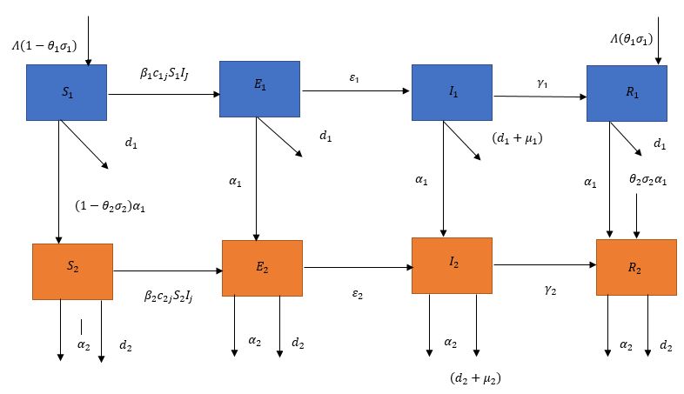
Methods
Subdivide the host population into two age groups,
Considering age-specific differences in vaccination schedules, mortality, and contact patterns
Figure 1: Model diagram for a measles vaccination model with two age group.

Slide 9
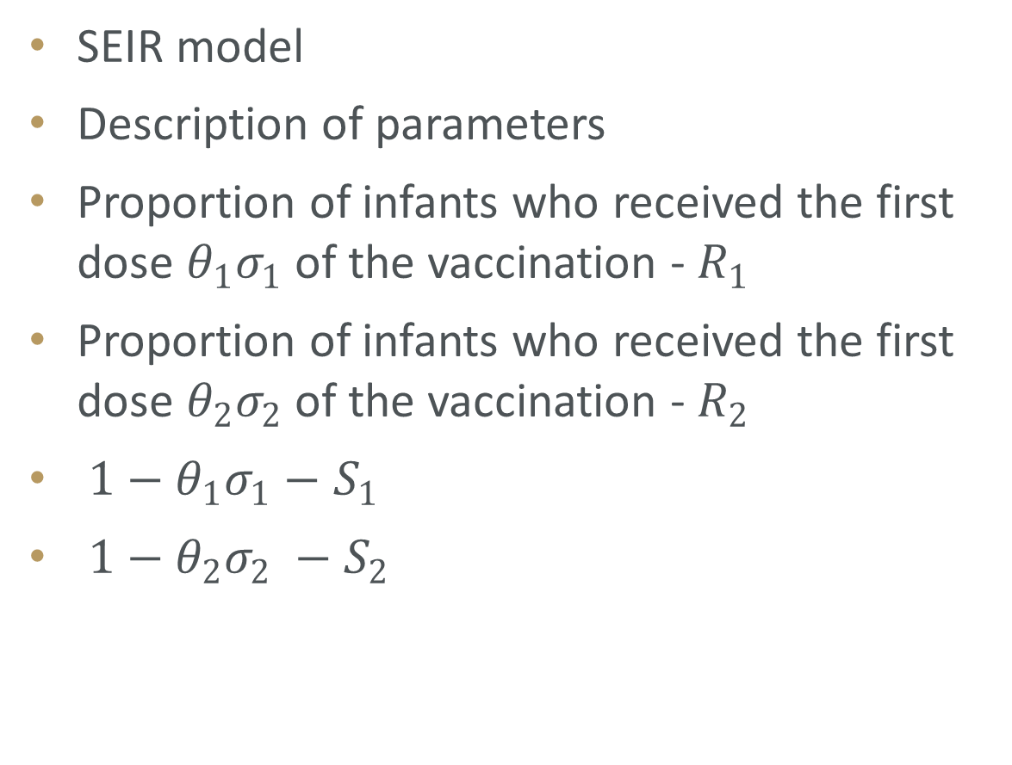
Measles vaccination model
SEIR model
Description of parameters
Proportion of infants who received the first dose $θ_{1}σ_{1}$ of the vaccination - $R_{1}$
Proportion of infants who received the first dose $θ_{2}σ_{2}$ of the vaccination - $R_{2}$
$1−θ_{1}σ_{1}−$ $S_{1}$
$1−θ_{2}σ_{2} −S_{2}$

Slide 10
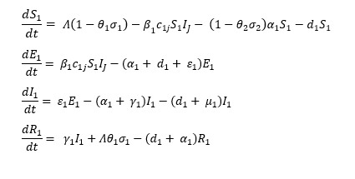
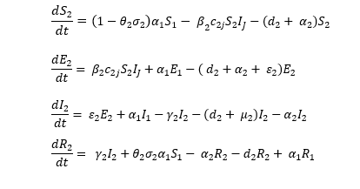
Methods
Differential equations for age group 1:
Differential equations for age group 2:

Slide 11
Parameter estimation
Compute the contact matrix for the population – Population data
Fitting the model using nonlinear least squared method
Aging rate is calculated
Aging rate of age group 1 resulted to 0.038
Aging rate of age group 2 resulted to 0.0038

Slide 12
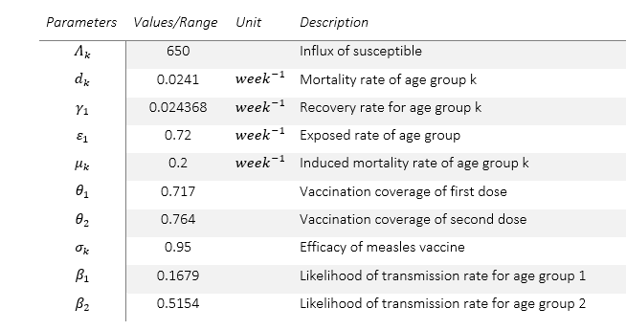
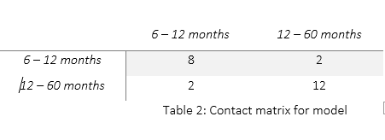
Methods
Model parameters and estimated values
Contact matrix for model
Model parameters and estimated values.

Slide 13
Methods
Immune profile analysis
Evaluate sustained effort of measles vaccination strategies
examine the percentage of population that has received vaccination
Increase vaccine coverage to 95%
Influence of increasing the vaccination coverage

Slide 14
Methods
Effect of improving vaccination coverage of measles
Explore different possibility of vaccine coverage rate
Increase vaccine coverage from 71.1% - 95%
Keep efficacy at 95%
Observe the influence of increasing the vaccination coverage

Slide 15
Limitations
Newborns are not included in the study
The children above the age of 5 years (60 months), young adults and adults, are not included in the study.
Code design
R studio (version 4.2.0)

Slide 16
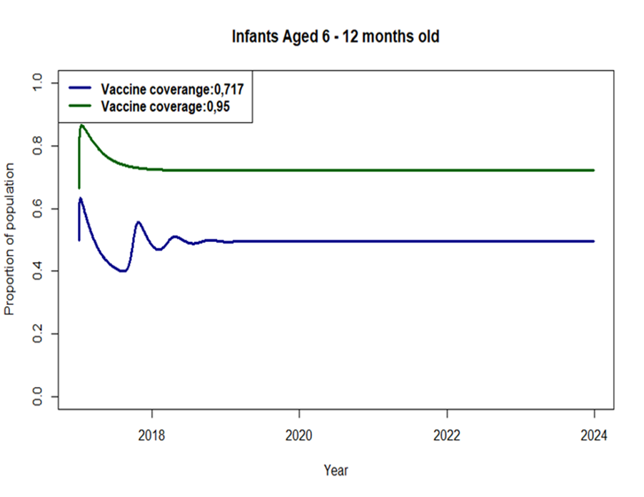
Immune profile analysis • Age-group 1 (6 – 12 months olds)
Immunity profiles of the population for infants aged 6 – 12 months.

Slide 17
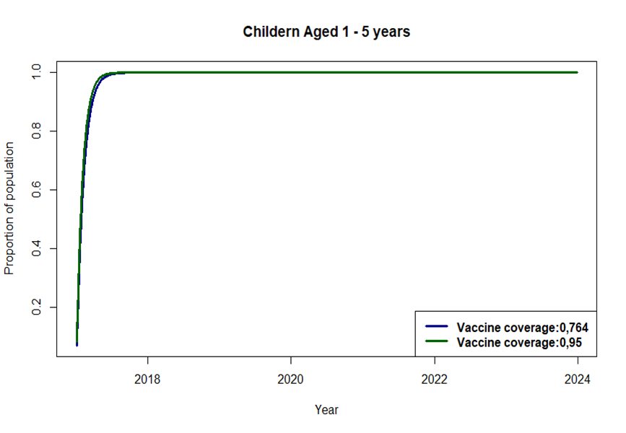
Immune profile analysis • Age-group 2 (12 – 60 months olds)
Immunity profiles of the population children aged 1 – 5 years.

Slide 18
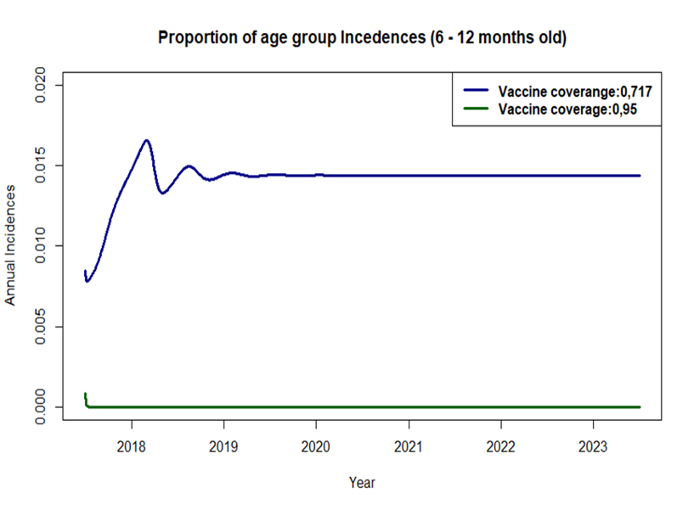
Effect of improving vaccination coverage of measles • Age-group 1 (6 – 12 months olds)
Proportion of measles incidence from age groups 1 under two different sets of vaccination coverage.

Slide 19
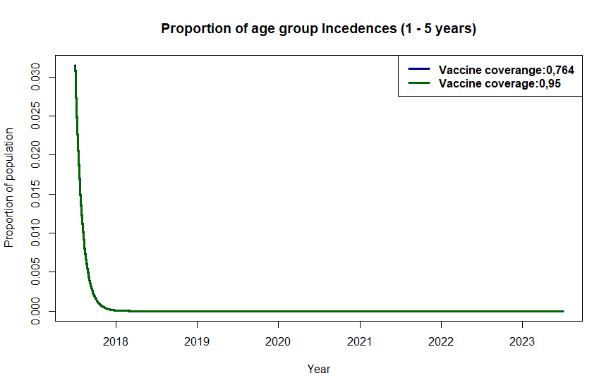
Effect of improving vaccination coverage of measles • Age-group 2 (12 – 60 months olds)
Proportion of measles incidence from age group 2 under two different sets of vaccination coverage.

Slide 20
Conclusion
Immunological Profile Analysis
Effectiveness of increasing vaccine coverage
World Health Organisation measles eradication aim for measles

Slide 21
References
L. Zhou, Y. Wang, Y. Xiao, and M. Y. Li, “Global dynamics of a discrete age-structured SIR epidemic model with applications to measles vaccination strategies,” Mathematical Biosciences 308, 27–37 (2019).
WHO Africa. Experts caution against stagnation of immunization coverage in Africa. 2019. Available at: https://www.afro.who.int/news/experts-caution-against-stagnationimmunization-coverage-africa
S. Edward, E. Kitengeso Raymond, T. Kiria Gabriel, F. Nestory, G. Mwema Godfrey, and P. Mafarasa Arbogast, “A mathematical model for control and elimination of the transmission dynamics of measles,” Applied and Computational Mathematics 4, 396–408 (2015)
O. Peter, O. Afolabi, A. Victor, C. Akpan, and F. Oguntolu, “Mathematical model for the control of measles,” Journal of Applied Sciences and Environmental Management 22, 571 (2018).
Moss, W.J. and Griffin, D.E., 2006. Global measles elimination. Nature Reviews Microbiology, 4(12), pp.900-908.
Battegay, R., Itin, C. and Itin, P., 2012. Dermatological signs and symptoms of measles: a prospective case series and comparison with the literature. Dermatology, 224(1), pp.1-
Enanoria, W.T., Liu, F., Zipprich, J., Harriman, K., Ackley, S., Blumberg, S., Worden, L. and Porco, T.C., 2016. The effect of contact investigations and public health interventions in the control and prevention of measles transmission: A simulation study. PloS one, 11(12), p.e0167160.
Centers for Disease Control and Prevention. Measles. Epidemiology and Prevention of Vaccine-Preventable Diseases. Hamborsky J, Kroger A, Wolfe S, eds. 13th ed. Washington D.C. Public Health Foundation, 2015.
Coale, A.J., 1957, January. How the age distribution of a human population is determined. In Cold spring harbor symposia on quantitative biology (Vol. 22, pp. 83-89). Cold Spring Harbor Laboratory Press.
Zhang, Z., Qiao, X., Yang, S. and Jiang, X., 2018. Non-uniform distribution of contamination on composite insulators in HVDC transmission lines. Applied Sciences, 8(10), p.1962.
Marelli, A.J., Mackie, A.S., Ionescu-Ittu, R., Rahme, E. and Pilote, L., 2007. Congenital heart disease in the general population: changing prevalence and age distribution. Circulation, 115(2), pp.163-172
National Institute Communicable Diseases. OUTBREAK RESPONSE UNIT, DIVISION OF PUBLIC HEALTH SURVEILLANCE AND RESPONSE; CENTRE FOR VACCINE AND IMMUNOLOGY. 2002. https://www.nicd.ac.za/wpcontent/uploads/2022/06/Measles-Vaccine-FAQ-_20220608.pdf
National Institute Communicable Diseases. ANNUAL MEASLES, RUBELLA AND CONGENITAL RUBELLA SURVEILLANCE REVIEW, SOUTH AFRICA, 2019

Slide 22

Thank you
Enkosi
Dankie
Photo by Stefan Els

